Slide 1
Analyzing NBA Shooting Trends: A Season in Review
An analysis on shooting trends found throughout the course of an NBA season

Slide 2
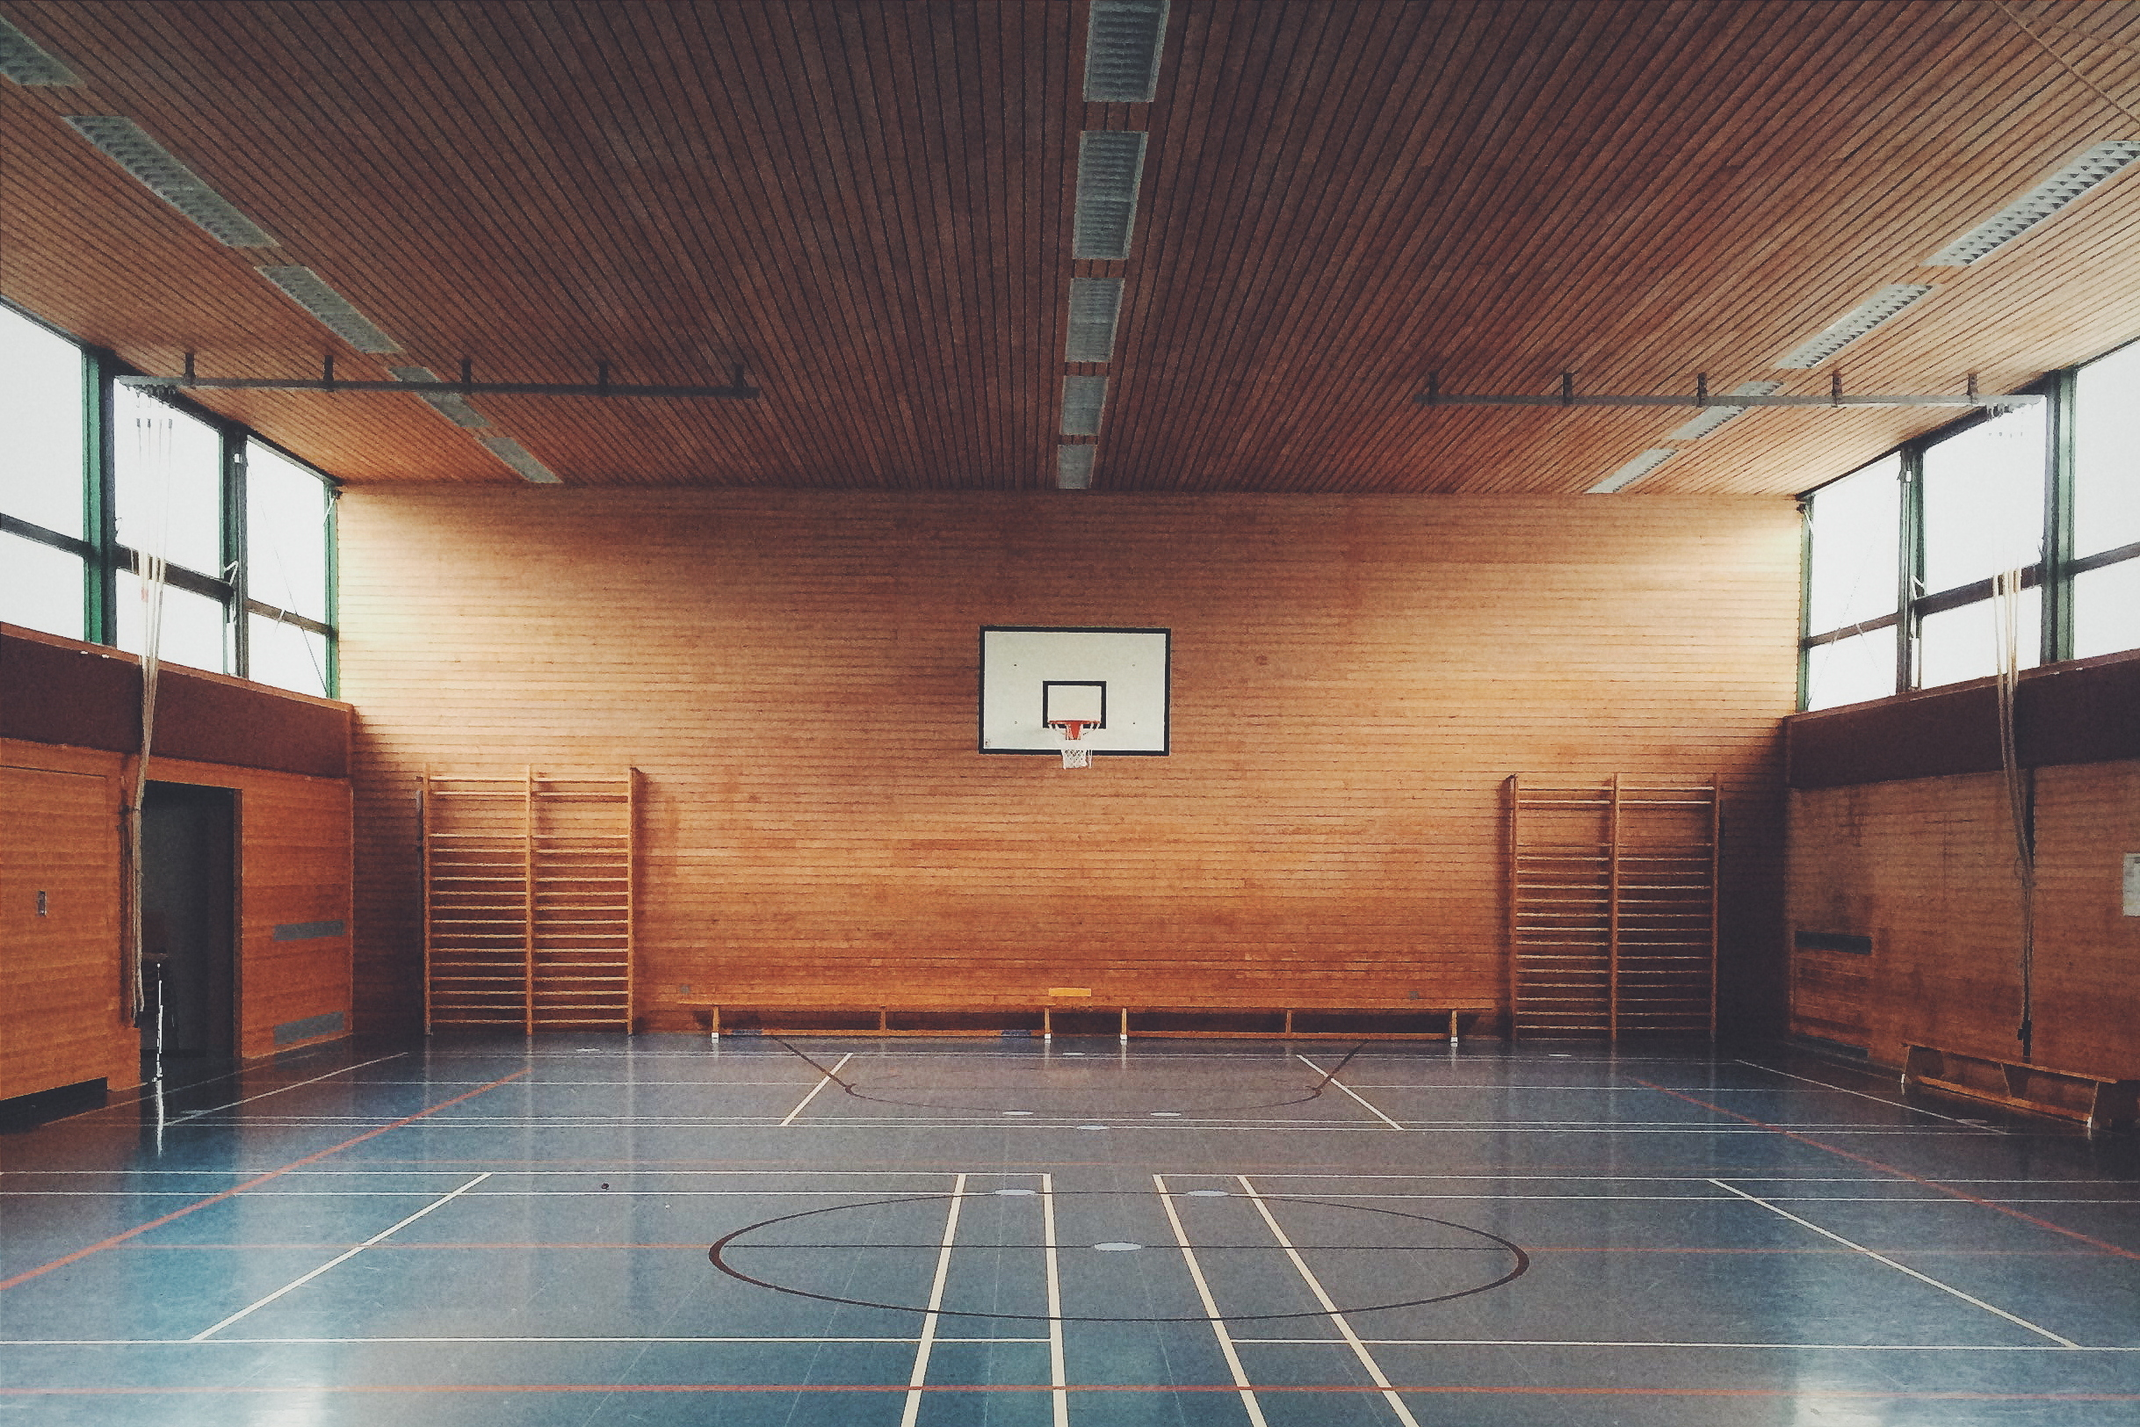
NOTE:
To change images on this slide, select a picture and delete it. Then click the Insert Picture icon
in the placeholder to insert your own image.
Tools and resources
Questions and hypothesis
Approach and analysis
Technical challenges
Two-point progression
Three-point progression
Player streakiness
Free-throw progression
Conclusions and next steps

Slide 3

Tools and resources
Data source
NBA.com via nba_api
Packages
Pandas
Seaborn
Project source code
github/jcarmfran

Slide 4
Approach and Analysis
Boxscore data downloaded using nba_api and used to assess daily shooting percentage averages throughout the course of the 2022-23 NBA season
Seaborn will be used to help visualize data and guide inferences from gathered statistics
Daily average

Slide 5
Questions and hypothesis
Are there shooting trends that appear as the season progresses?
2P%
Two-point percentages should stay about the same as the season progresses
3P%
Players should get more comfortable shooting threes as the season progresses, resulting in a higher proportion of shots beyond the arc to go in.
Is there data that can help assess if “streaky” labels of players are warranted?
So called “streaky” players should revert back to mean more often throughout the course of the season often enough to debunk this notion.
What kind of patterns should we expect as far as free-throw percentage is concerned?
As the season progresses, we should expect to see players convert a larger proportion of their free-throw attempts.

Slide 6

Technical challenges
The nba_api can be cumbersome to use and is still subject to typical data collection roadblocks/limitations (timeouts, temp. blocks, etc.)
Seaborn is simply a visualization tool and is limited in more in-depth statistical charting
Much of the data we are looking for has simply not been aggregated for and needs to be calculated ad-hoc

Slide 7
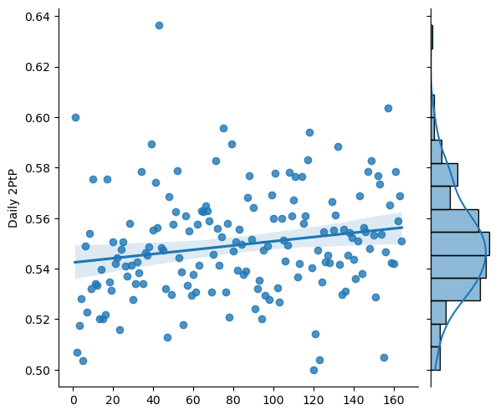
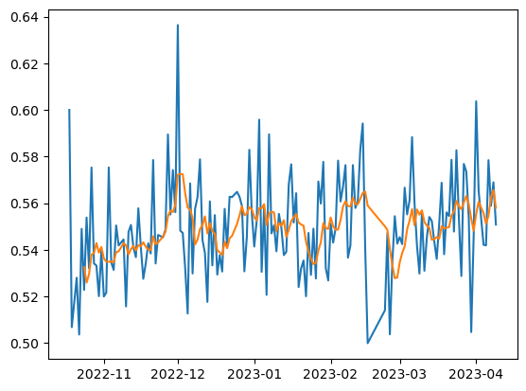
Q1-A. Are there league wide 2P% shooting patterns throughout the course of a season?
Scatter plot of daily two-point shooting percentages show
Normal distribution among percentage of two-point shot makes
Upward trending regression + 7-day MA
Upward trending 7-day moving average of shots made as
7-day 2P% moving average

Slide 8
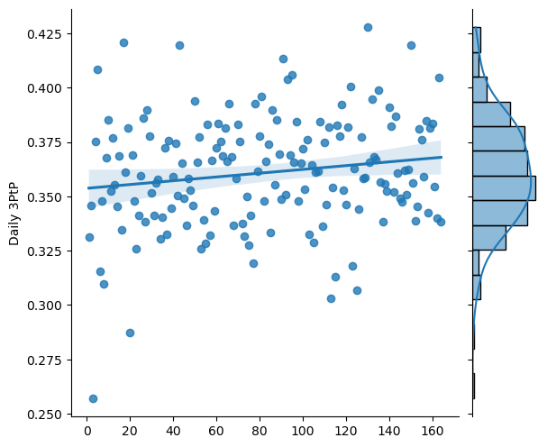
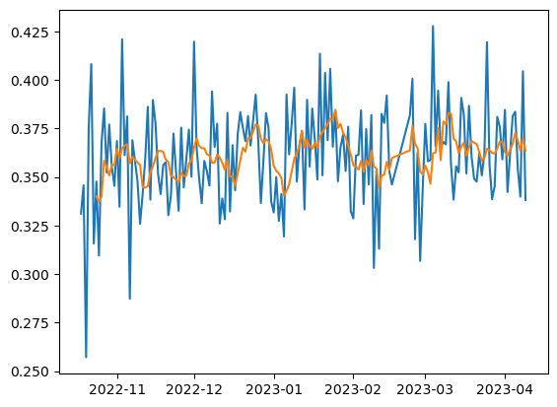
Q1-B. Are there league wide 3P% shooting patterns throughout the course of a season?
Scatter plot of daily three-point shooting percentages show
Normal distribution
Regression line indicating upward tendency as season progresses
Normal distribution among percentage of three-point shot makes
Upward trending regression + 7-day MA
Upward trending 7-day moving average of shots made as
7-day 3P% moving average

Slide 9
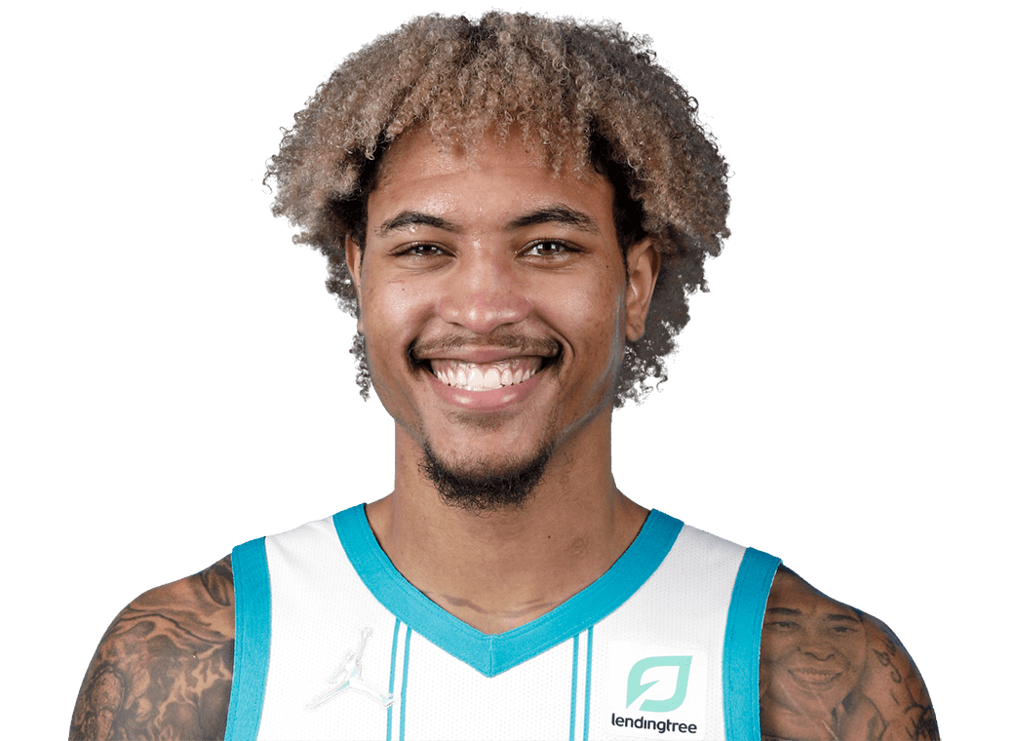
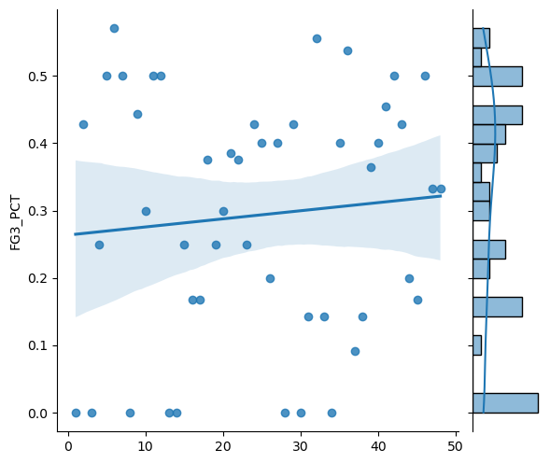
Q2. Are there players in the league who are deserving of their “streaky” label?
The stats seem to back up the claim that Kelly Oubre Jr. (widely considered one of the streakiest shooters in the league) is either red hot from beyond the arc or down right ice cold.
Of the 48 games Kelly Oubre played in the 2022-23 season, the five most likely 3P% outcomes we should come to expect…
0% - 8 times – 16.7% of games
50% - 6 times – 12.5% of games
42.9% - 4 times – 8.3% of games
25% - 4 times – 8.3% of games
40% - 4 times – 8.3% of games

Slide 10
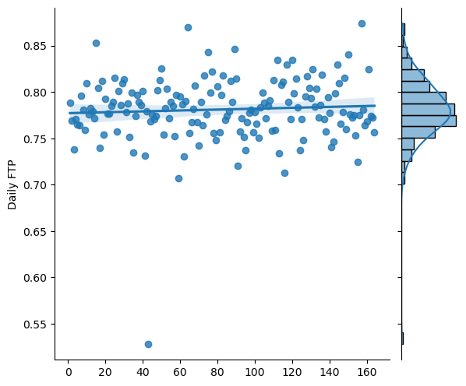
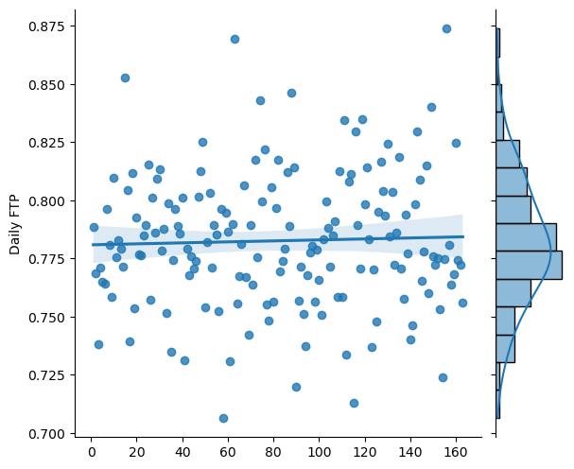
Q3. Are there league wide FT% patterns throughout the course of a season?
Joint plot of daily FT% throughout the course of the season
Normal distribution
Regression line indicating upward tendency as season progresses
The plots to the left indicate that if there is a trend to be observed as far as FT% conversion rate is concerned, it is only a gradual increase of the conversion rate of FT attempts as the season progresses.
Joint plot excluding anomalous low FT% scoring days

Slide 11
Conclusions
Q1 A+B: Are there league-wide shooting patterns that develop over the course the season?
Yes, there is a noticeable trend where players tend to make a higher proportion of their shots as the season progresses. Though two-points shot percentage increased, the most noticeable increase in shot conversion could be seen in three-point attempts.
Q2: Is the notion of “streaky” players in the NBA outdated?
There is reason to believe that some players do indeed exhibit a tendency to be erratic in their 3PT%.
More analysis needed on this question as methodology could be improved.
Q3: Are there league-wide free-throw patterns that develop over the course the season?
The conversion rate of free-throws does increase throughout the course of the season does seem to increase, albeit it very small.
As a general rule of thumb, you should expect players to shoot better as the season progresses.

Slide 12
Next Steps
Continue collecting the box scores of previous seasons to further determine if this trend is something we can rely on happening every season.
Reassess two-point attempts with categorized distances from the basket.
Develop a better model to categorize who has been labeled “streaky”.
Formulate a model that helps gauge if a shooter is likely to hit their next shot given the success/failure of their most recent attempts (in game streakiness).
Develop a more robust data pipeline
Python → API → Data → SQL → Processing

